Slide 1
Department of Applied Mathematics and Computational Sciences
III Sem M.Sc.Software Systems
Transform Techniques
Dr. V. Suresh kumar

Slide 2
Discrete Fourier Transform

Slide 3
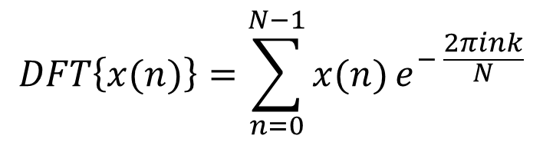
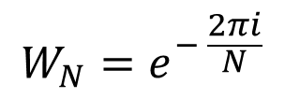
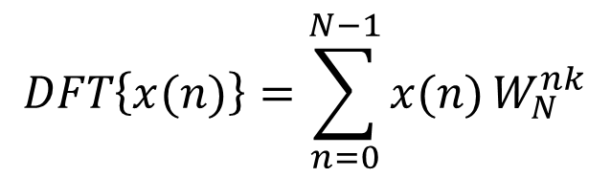

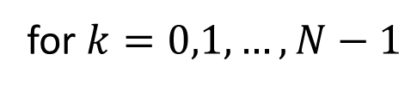
Discrete Fourier Transform (DFT)
Suppose $\left\{x(n)\right\}$ is assumed to be a finite sequence of duration $N$ then the Discrete Fourier Transform of $\left\{x(n)\right\}$ denoted as $DFT\left\{x(n)\right\}$ and defined as
$$DFT\left\{x(n)\right\}=\sum_{n=0}^{N−1}{x(n)}e^{− \frac{2πink}{N}}$$
$$DFT\left\{x(n)\right\}=X(k)$$
for $k=0,1,…,N−1$
Phase factor
$${W_{N}=e}^{− \frac{2πi}{N}}$$
$$DFT\left\{x(n)\right\}=\sum_{n=0}^{N−1}{x(n)}W_{N}^{nk}$$

Slide 4
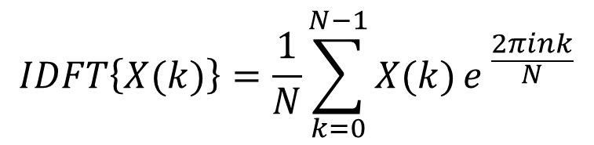

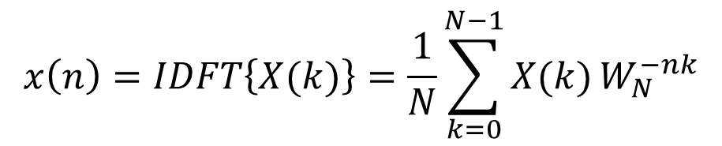

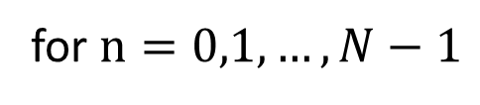
Inverse formula
The Inverse Discrete Fourier Transform of $X(k)$ denoted as $IDFT\{X\left(k\right)\}$ and defined as
$$IDFT\left\{X(k)\right\}=\frac{1}{N}\sum_{k=0}^{N−1}{X(k)}e^{ \frac{2πink}{N}}$$
$$IDFT\left\{X(k)\right\}=x(n)$$
for $n=0,1,…,N−1$
$$x\left(n\right)=IDFT\left\{X(k)\right\}=\frac{1}{N}\sum_{k=0}^{N−1}{X(k)}W_{N}^{−nk}$$

Slide 5
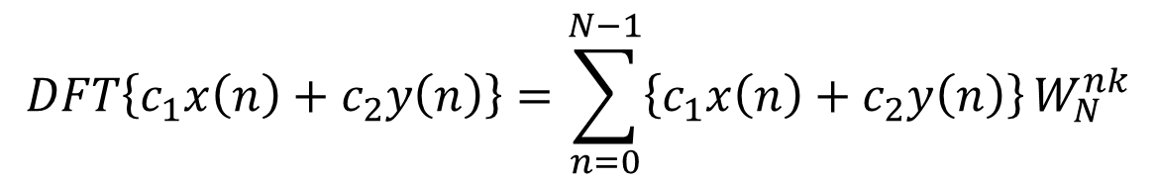
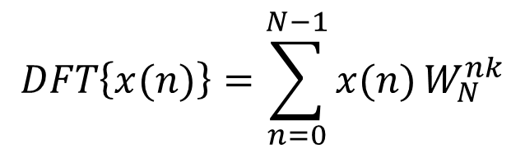

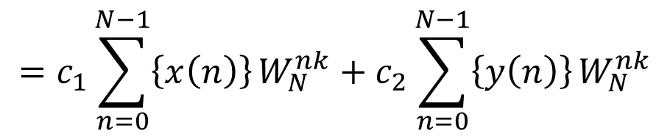
Properties
Linear Property:
$$DFT\left\{c_{1}x\left(n\right)+c_{2}y\left(n\right)\right\}=c_{1}DFT\left\{x\left(n\right)\right\}+c_{2}DFT\{y\left(n\right)\}$$
Proof:
$$DFT\left\{x(n)\right\}=\sum_{n=0}^{N−1}{x(n)}W_{N}^{nk}$$
$$DFT\left\{c_{1}x\left(n\right)+c_{2}y\left(n\right)\right\}=\sum_{n=0}^{N−1}{\left\{c_{1}x\left(n\right)+c_{2}y\left(n\right)\right\}}W_{N}^{nk}$$
$$=c_{1}\sum_{n=0}^{N−1}{\left\{x\left(n\right)\right\}}W_{N}^{nk}+c_{2}\sum_{n=0}^{N−1}{\left\{y\left(n\right)\right\}}W_{N}^{nk}$$
$$=c_{1}DFT\left\{x\left(n\right)\right\}+c_{2}DFT\{y\left(n\right)\}$$

Slide 6
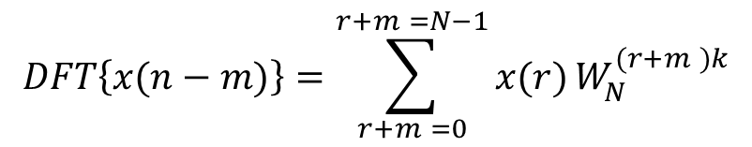







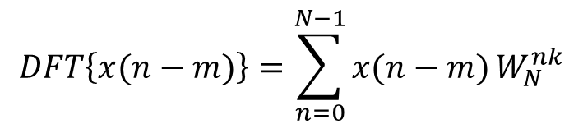
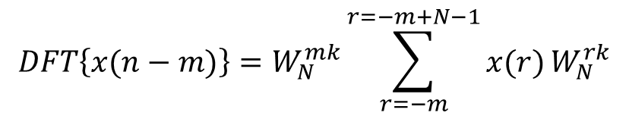
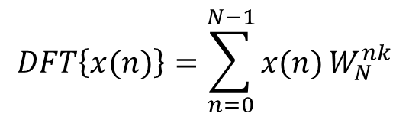
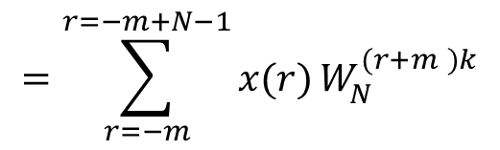

Property contd…
Shifting Property:
$$DFT\left\{x\left(n−m\right)\right\}=W_{N}^{mk}DFT\left\{x\left(n\right)\right\}$$
for the periodic sequence $\{x\left(n\right)\}$ of period $N$
Proof:
$$=\sum_{r=−m}^{r=−m+N−1}{x(r)}W_{N}^{(r+m )k}$$
$$DFT\left\{x(n)\right\}=\sum_{n=0}^{N−1}{x(n)}W_{N}^{nk}$$
$$DFT\left\{x(n−m)\right\}=W_{N}^{mk}\sum_{r=−m}^{r=−m+N−1}{x(r)}W_{N}^{rk}$$
$$DFT\left\{x(n−m)\right\}=\sum_{n=0}^{N−1}{x(n−m)}W_{N}^{nk}$$
(1)
Consider
$${W_{N}=e}^{− \frac{2πi}{N}}$$
Put $r=n−m$ in the RHS of the sum
$$W_{N}^{rk}={\left(e^{− \frac{2πi}{N}}\right)}^{rk}$$
$$n=r+m$$
$$DFT\left\{x(n−m)\right\}=\sum_{r+m =0}^{r+m =N−1}{x(r)}W_{N}^{(r+m )k}$$
$${=e}^{− \frac{2πirk}{N}}$$
$$W_{N}^{(r+N)k}=e^{− \frac{2πi(r+N)k}{N}}$$

Slide 7
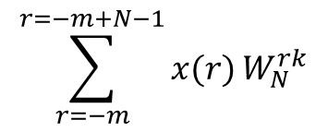

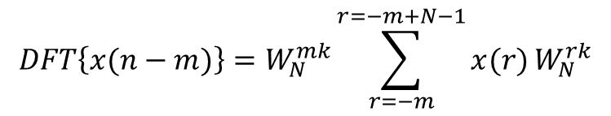




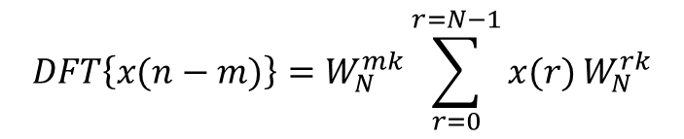

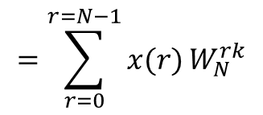
Shifting Property contd…
$$W_{N}^{(r+N)k}=e^{− \frac{2πirk}{N}}e^{− \frac{2πiNk}{N}}$$
(1)
$$DFT\left\{x(n−m)\right\}=W_{N}^{mk}\sum_{r=−m}^{r=−m+N−1}{x(r)}W_{N}^{rk}$$
$$={\left(e^{− \frac{2πi}{N}}\right)}^{rk}{\left(e^{−2πi}\right)}^{k}$$
$${=\left(e^{− \frac{2πi}{N}}\right)}^{rk}$$
$$W_{N}^{(r+N)k}=W_{N}^{rk}$$
$$DFT\left\{x(n−m)\right\}=W_{N}^{mk}\sum_{r=0}^{r=N−1}{x(r)}W_{N}^{rk}$$
$W_{N}^{rk}$ is a periodic sequence with period $N$
$$DFT\left\{x\left(n−m\right)\right\}=W_{N}^{mk}DFT\left\{x\left(n\right)\right\}$$
$$\sum_{r=−m}^{r=−m+N−1}{x(r)}W_{N}^{rk}$$
$$=\sum_{r=0}^{r=N−1}{x(r)}W_{N}^{rk}$$

Slide 8
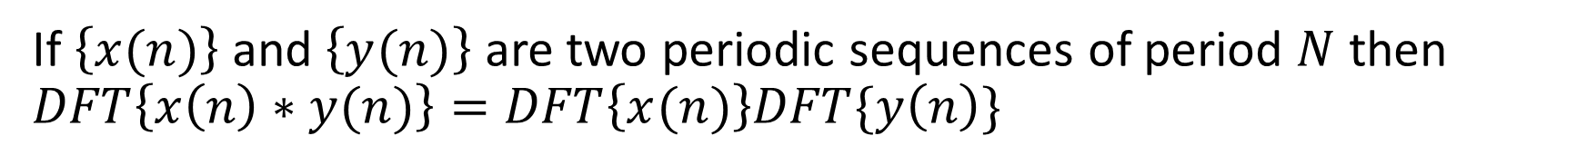
Property contd…
Convolution Property
If $\left\{x(n)\right\}$ and $\left\{y(n)\right\}$ are two periodic sequences of period $N$ then $DFT\left\{x\left(n\right)∗y(n)\right\}=DFT\left\{x(n)\right\}DFT\{y\left(n\right)\}$

Slide 9


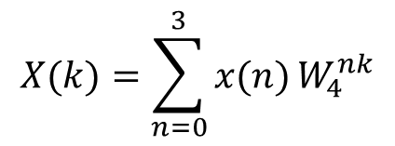


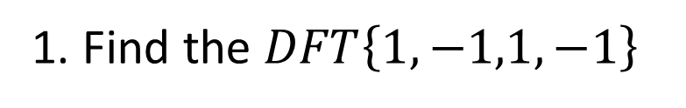



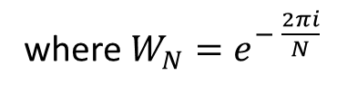


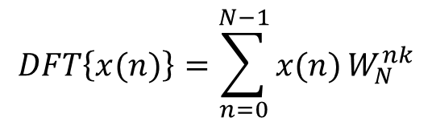


Example problems
1. Find the $DFT\left\{1,−1,1,−1\right\}$
Ans:
$$DFT\left\{x(n)\right\}=\sum_{n=0}^{N−1}{x(n)}W_{N}^{nk}$$
where ${W_{N}=e}^{− \frac{2πi}{N}}$
Take $x\left(n\right)=\left\{1,−1, 1,−1\right\}$
$$N=4$$
$$x\left(0\right)=1$$
$$x\left(1\right)=−1$$
$$x\left(2\right)=1$$
$$x\left(3\right)=−1$$
$$X(k)=\sum_{n=0}^{3}{x(n)}W_{4}^{nk}$$
For $k=0, 1, 2, 3$
$${W_{4}=e}^{− \frac{2πi}{4}}$$
$${=e}^{− \frac{iπ}{2}}$$
$$X\left(k\right)=x\left(0\right)+x\left(1\right)W_{4}^{k}+x\left(2\right)W_{4}^{2k}+x(3)W_{4}^{3k}$$
$$=\cos\left(\frac{π}{2}\right)−i\sin\left(\frac{π}{2}\right)$$
$$W_{4}=−i$$

Slide 10








Example contd…
$$X\left(k\right)=x\left(0\right)+x\left(1\right)W_{4}^{k}+x\left(2\right)W_{4}^{2k}+x(3)W_{4}^{3k}$$
$$X\left(0\right)=x\left(0\right)+x\left(1\right)+x\left(2\right)+x(3)$$
$$X\left(0\right)=1−1+1−1$$
$$X\left(0\right)=0$$
$$X\left(1\right)=x\left(0\right)+x\left(1\right)W_{4}^{1}+x\left(2\right)W_{4}^{2}+x(3)W_{4}^{3}$$
$$X\left(1\right)=1−1(−i)+1{\left(−i\right)}^{2}−1{\left(−i\right)}^{3}$$
$$X\left(1\right)=0$$
$$X\left(2\right)=x\left(0\right)+x\left(1\right)W_{4}^{2}+x\left(2\right)W_{4}^{4}+x(3)W_{4}^{6}$$
$$X\left(2\right)=1−1{\left(−i\right)}^{2}+1{\left(−i\right)}^{4}−1{\left(−i\right)}^{6}$$
$$X\left(2\right)=4$$
$$X\left(3\right)=1−1{\left(−i\right)}^{3}+1{\left(−i\right)}^{6}−1{\left(−i\right)}^{9}$$
$$X\left(3\right)=x\left(0\right)+x\left(1\right)W_{4}^{3}+x\left(2\right)W_{4}^{6}+x(3)W_{4}^{9}$$
$$X\left(3\right)=0$$
$$X\left(k\right)=\left\{0, 0, 4, 0\right\}$$

Slide 11


